Slide 1
Coursework 2016/17
Example Structure & Logic for Coursework

Slide 2
Example Logical Workflow
NOT a definitive solution to the coursework problem
Merely an example of how it could be implemented
Some components are not fully worked
Meant to guide you – not the answer to your problems
Some steps are missed out
Validation of data is (mostly) assumed
main()

Slide 3
Suggested Components
import statements
Request Class (with __init__, displayall and displayrestricted methods)
main() – the main function
Three primary functions (create, edit and match)
Other functions (getrandom, validate, makefile, readfile)
Data acquistition functions (campus, prog, module, year, slots)
main()

Slide 4
Overview – Basic Program Structure

Slide 5
main() function

Slide 6
create() function

Slide 7
edit() function

Slide 8
match() function

Slide 9
validate() function

Slide 10
campus() function – example of data acquisition

Slide 11
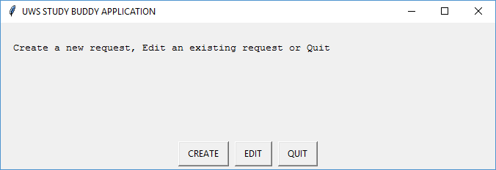
menu

Slide 12
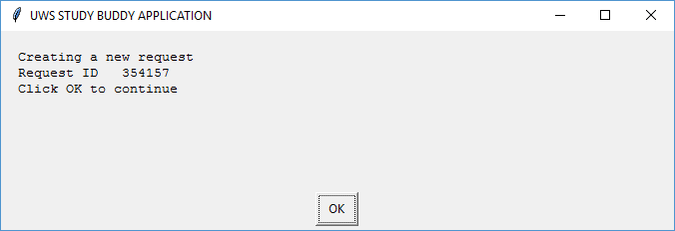
create

Slide 13
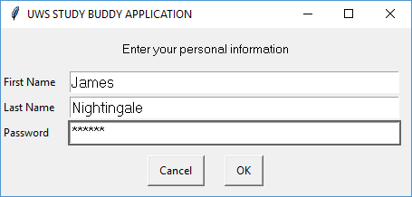
Enter name and password

Slide 14
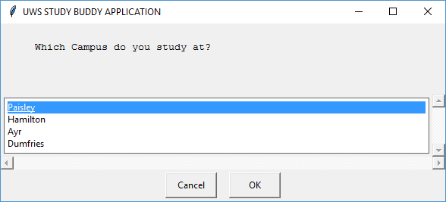
Select Campus of Study

Slide 15
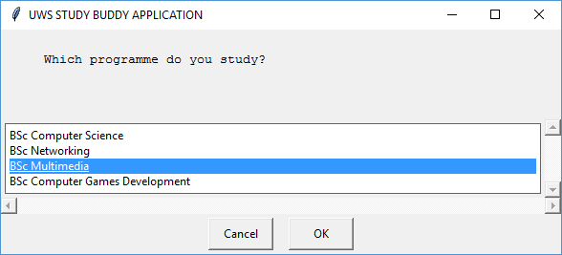
Select Programme of Study

Slide 16
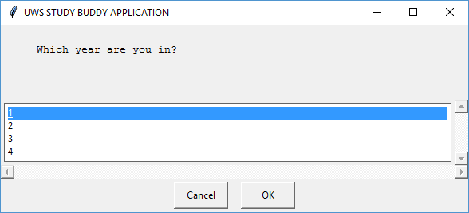
Select Year of Study

Slide 17
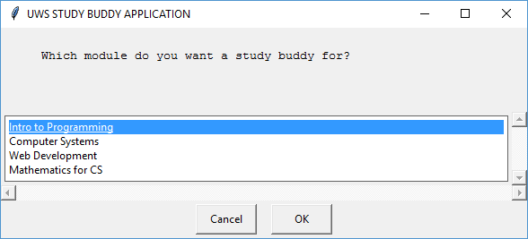
Select Module of Study

Slide 18
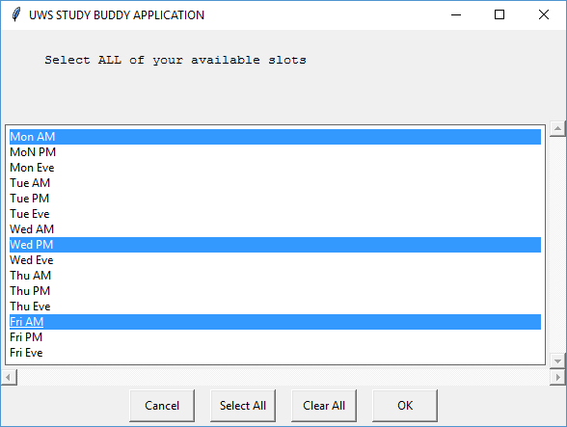
Select Time Slots

Slide 19
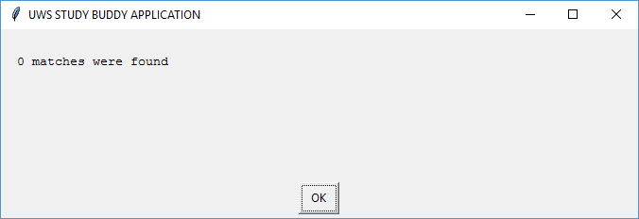
Report Matches

Slide 20
No Matches – return to menu

Slide 21
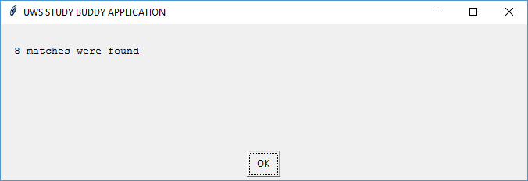
Report Matches

Slide 22
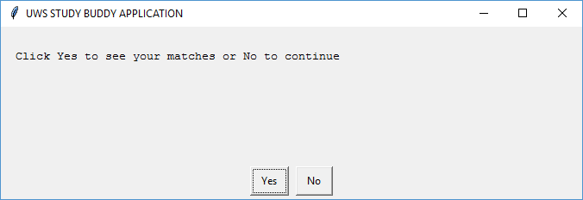
Report Matches – display matches Y/N?

Slide 23
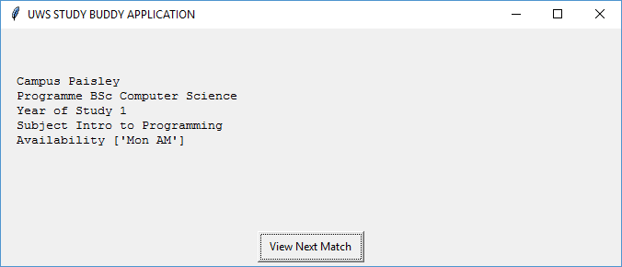
Report Matches – display matches

Slide 24
Report Matches – display matches done go to menu

Slide 25
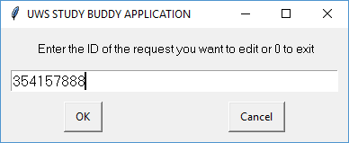
Edit – enter the request ID

Slide 26
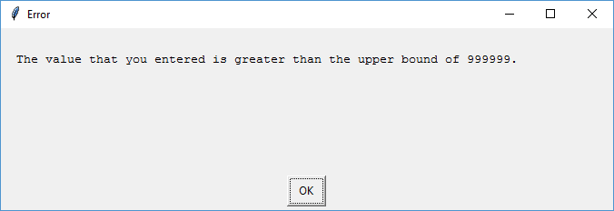
Edit – invalid request ID (>999999)

Slide 27
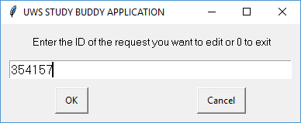
Edit – re-enter request ID

Slide 28
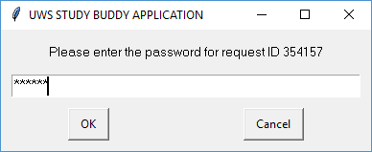
Edit – enter password

Slide 29
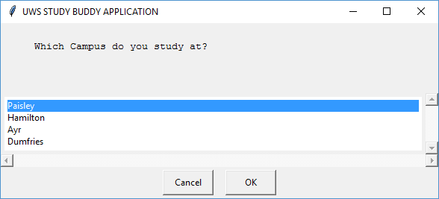
Edit – Campus (original choice preselected)

Slide 30

Edit – Programme (original choice preselected)

Slide 31
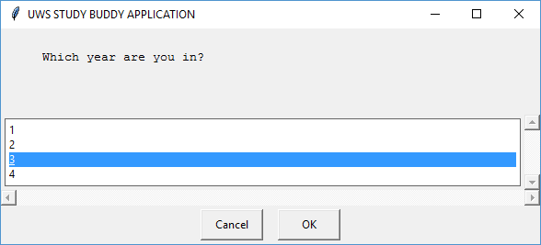
Edit – Year (new choice selected)

Slide 32
Edit – Module (original choice preselected)

Slide 33
Edit – Time Slots (original choice preselected)

Slide 34
Edit – Matching rerun after edit

Slide 35
Edit – back to menu when edit done

Slide 36
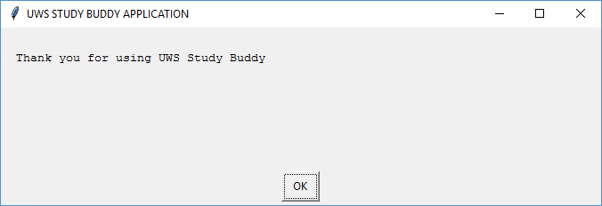
Quit – Goodbye Message

